Slide 1
Software Process Models
Instructor: Mehroze Khan

Slide 2
Software Life Cycle
When the process involves the building of some product, we sometimes refer to the process as a life cycle. Thus, the software development process is sometimes called the software life cycle, because it describes the life of a software product from its conception to its implementation, delivery, use, and maintenance.

Slide 3
Software Life Cycle
Software development usually involves the following stages:
Requirements analysis and definition
System design
Program design
Writing the programs (program implementation)
Unit testing
Integration testing
System testing
System delivery
Maintenance

Slide 4
Process
A process is defined as a collection of work activities, actions, and tasks that are performed when some work product is to be created.
Each of these activities, actions, and tasks reside within a framework or model that defines their relationship with the process and with one another.
A software process is a framework for the activities, actions, and tasks that are required to build high-quality software.

Slide 5
Generic Process Framework
A generic process framework for software engineering defines five framework activities:
Communication
Planning
Modeling
Construction
Deployment

Slide 6
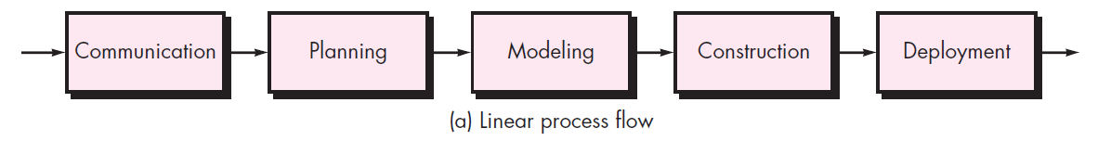
Process Flow
Process flow—describes how the framework activities and the actions and tasks that occur within each framework activity are organized with respect to sequence and time.
A linear process flow executes each of the five framework activities in sequence, beginning with communication and culminating with deployment.

Slide 7
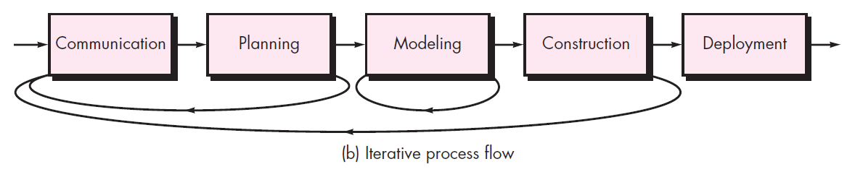
Process Flow
An iterative process flow repeats one or more of the activities before proceeding to the next.

Slide 8
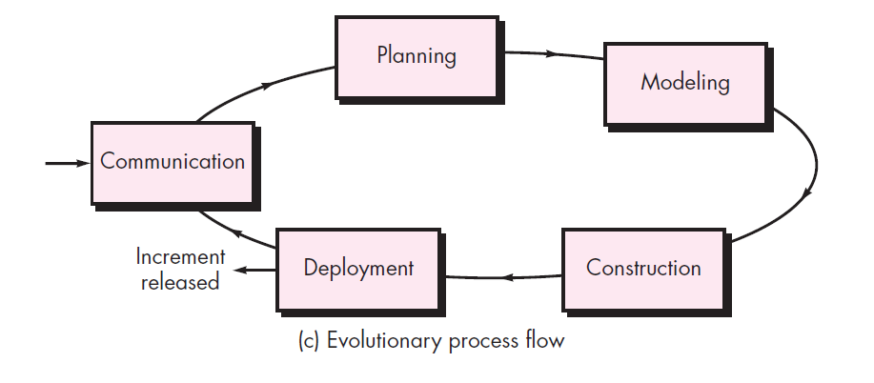
Process Flow
An evolutionary process flow executes the activities in a “circular” manner. Each circuit through the five activities leads to a more complete version of the software.

Slide 9
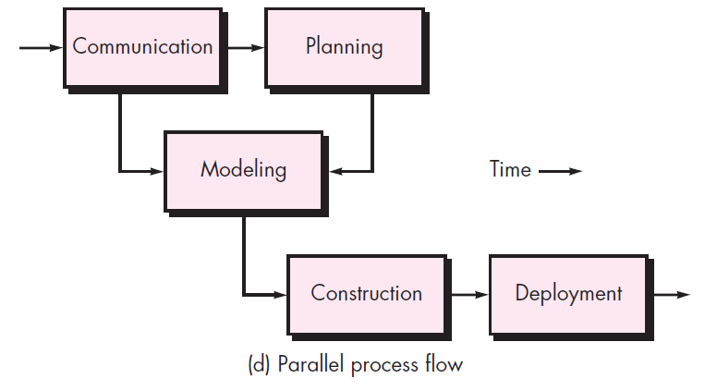
Process Flow
A parallel process flow executes one or more activities in parallel with other activities (e.g., modeling for one aspect of the software might be executed in parallel with construction of another aspect of the software).

Slide 10
Task Set
For a small software project requested by one person (at a remote location) with simple, straightforward requirements, the communication activity might encompass little more than a phone call with the appropriate stakeholder. Therefore, the only necessary action is phone conversation, and the work tasks (the task set) that this action encompasses are:
Contact stakeholder via telephone.
Discuss requirements and take notes.
Organize notes into a brief written statement of requirements.
E-mail to stakeholder for review and approval.

Slide 11
Task Set
If the project was considerably more complex with many stakeholders, each with a different set of (sometime conflicting) requirements, the communication activity might have six distinct actions:
Inception
Elicitation
Elaboration
Negotiation
Specification
Validation.

Slide 12
Task Set
Inception: The initial stage where the project is conceived, and the goals and objectives are outlined.
Identifying the key stakeholders, understanding their initial requirements, and setting the project's overall direction.
Elicitation: The process of gathering information and requirements from stakeholders to understand their needs and expectations.
Conducting interviews, surveys, workshops, or other methods to extract relevant information from stakeholders.
Elaboration: The stage where gathered requirements are analyzed and detailed to create a comprehensive understanding of the project scope.
Breaking down high-level requirements into more detailed specifications, creating use cases, and developing a more intricate project plan.
Negotiation: The process of reconciling conflicting requirements and priorities among stakeholders.
Facilitating discussions and negotiations to resolve conflicts, finding compromises, and ensuring alignment among stakeholders.
Specification: The formal documentation and communication of detailed project requirements and specifications.
Creating detailed documentation, such as requirements documents, design specifications, and other relevant materials that serve as a reference for project development.
Validation: The stage where the documented requirements are reviewed and verified to ensure they meet the stakeholders' expectations.
Conducting reviews, inspections, and tests to validate that the project deliverables align with the specified requirements and meet the intended objectives.

Slide 13
Software Development Process Models
Waterfall model
Classical
With prototyping
V model
Prototyping model
Phased development: increments and iterations
Spiral model
Unified process
Rapid Application Development (RAD)
Agile methods
XP
Scrum
Kanban

Slide 14
The Waterfall Model
One of the first process development models proposed
Works for well understood problems with minimal or no changes in the requirements
Simple and easy to explain to customers
It presents
a very high-level view of the development process
sequence of process activities
Each major phase is marked by milestones and deliverables (artefacts)

Slide 15
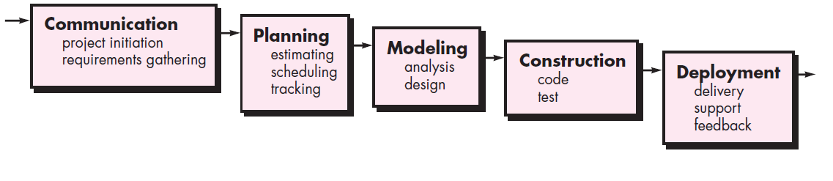
The Waterfall Model

Slide 16
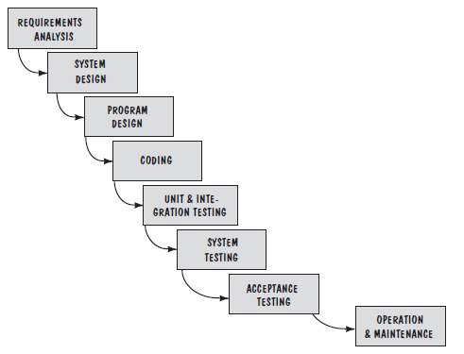
The Waterfall Model

Slide 17
The Waterfall Model
Provides no guidance how to handle changes to products and activities during development (assumes requirements can be frozen)
Views software development as manufacturing process rather than as building process
There are no iterative activities that lead to building a final product
Long wait before a final product
Generates lots of documentation
Considered suitable for large projects

Slide 18
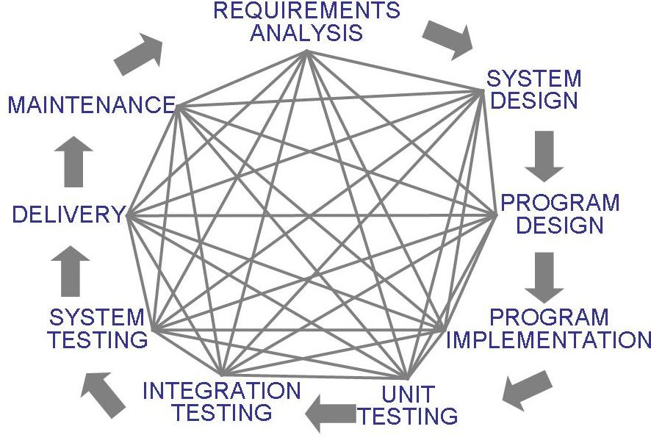
The Waterfall Model
Uncontrolled Software Development Process
No Iterations in WF?

Slide 19
Problems with Waterfall Model
Real projects rarely follow the sequential workflow that the model proposes.
It is often difficult for the customer to state all requirements explicitly at the beginning of most projects.
The customer must have patience because a working version of the program(s) will not be available until late in the project time span.
Major blunders may not be detected until the working program is reviewed.

Slide 20
Waterfall Model with Prototyping
A prototype is a partially developed product
Prototyping helps
developers assess alternative design strategies (design prototype)
users understand what the system will be like (user interface prototype)

Slide 21
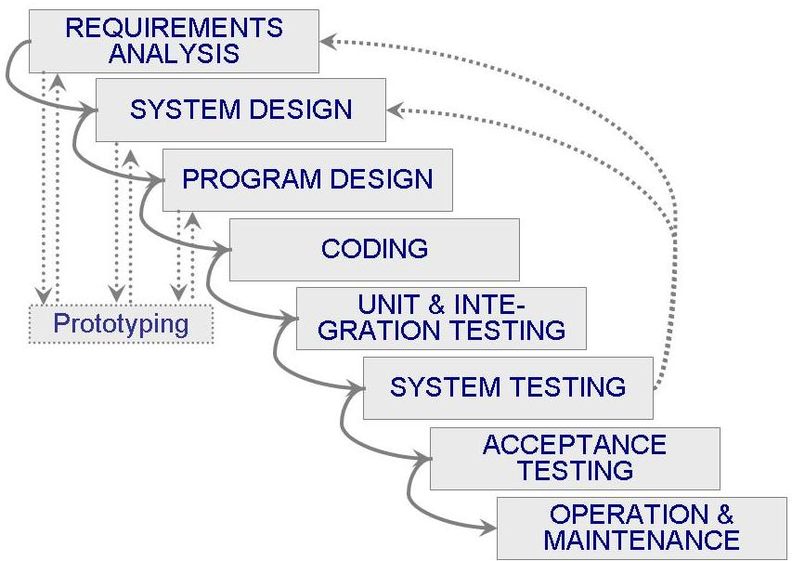
Waterfall Model with Prototyping

Slide 22
The V-Model
A variant of the waterfall model
Uses unit testing to verify procedural design
Uses integration testing to verify architectural (system) design
Uses acceptance testing to validate the requirements
If problems are found during verification and validation, the left side of the V can be re-executed before testing on the right side is re-enacted
Verification: Each function works correctly
Validation: All requirements have been implemented and each functionality can be traced back to a particular requirement

Slide 23
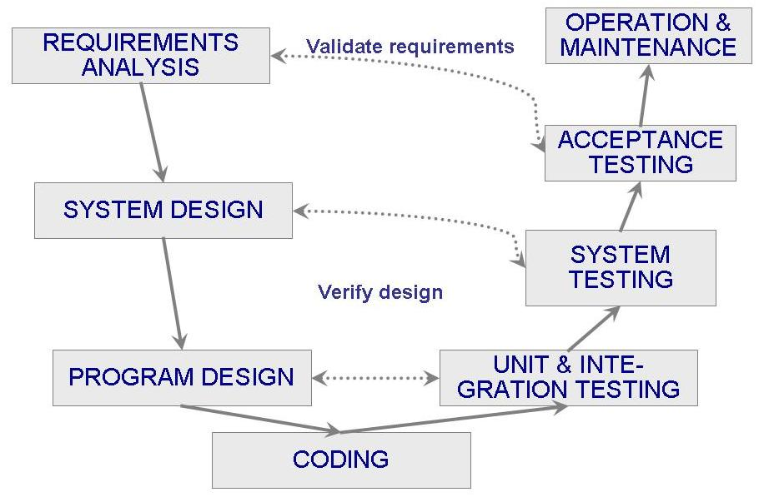
The V-Model

Slide 24
Phased Development
Cycle time
Time between when requirements document was written and when the system was delivered
Shorter cycle time
Decomposed system
System delivered in pieces
enables customers to have some functionality while the rest is being developed
Two systems functioning in parallel
the production system (release n): currently being used
the development system (release n+1): the next version

Slide 25
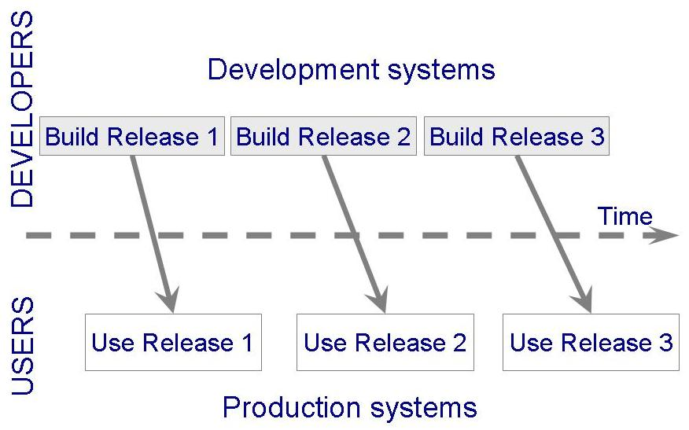
Phased Development

Slide 26
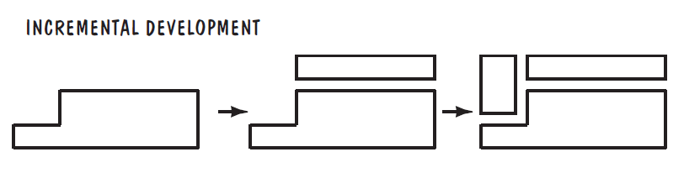
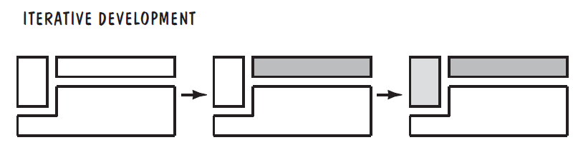
Phased Development
Incremental development: starts with small functional subsystem and adds functionality with each new release
Iterative development: delivers a full system at the very beginning and then changes the functionality of each subsystem with each new release.
Notes:
To understand the difference between incremental and iterative development, consider a word processing package. Suppose the package is to deliver three types of functionality: creating text, organizing text (i.e., cutting and pasting), and formatting text (such as using different type sizes and styles).

Slide 27
Phased Development
Training on early release
Responsive developers
Markets for early functionality
Quick and Global fixing on unanticipated problems
Ability to work on different areas of expertise with different releases

Slide 28
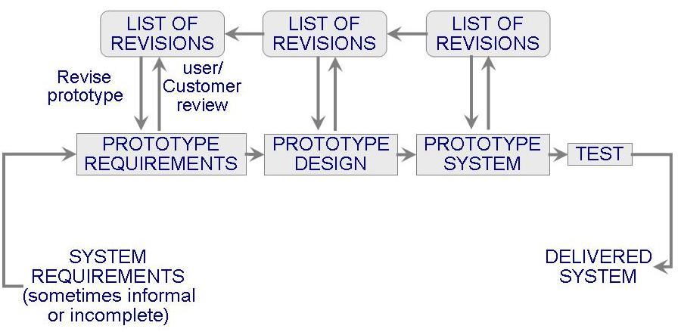
Prototyping Model
Allows repeated investigation of the requirements or design
Reduces risk and uncertainty in the development

Slide 29
Prototyping Model
Pros:
There is a reduced impact of requirement changes.
The customer is involved early and often.
It works well for small projects.
There is reduced likelihood of product rejection.
Cons:
Customer involvement may cause delays.
There may be a temptation to “ship” a prototype.
Work is lost in a throwaway prototype.
It is hard to plan and manage.

Slide 30
References
Shari PFleeger, Joanne Atlee, Software Engineering: Theory and Practice, 4th Edition
Roger S. Pressman, Software Engineering A Practitioner’s Approach, 9th Edition. McGrawHill

